Slide 1

Lazarus Game
Eric Gonzalez

Slide 2
Differences
With Wingman Game
No Powerups
No Bullets
No Second Player
No Up or Down Key Events
No Health Bar, Only 1 Life
No Score
No Moving Background

Slide 3
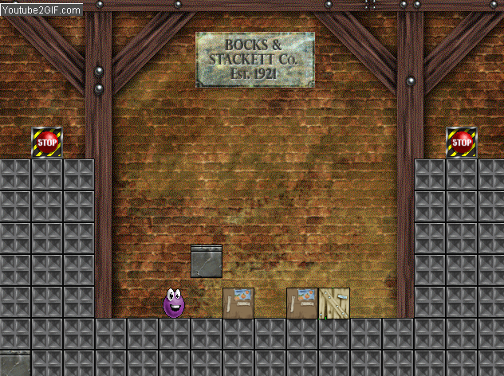
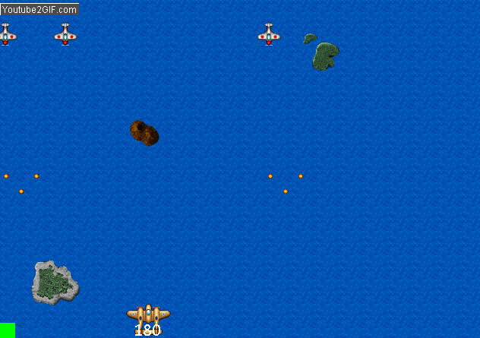
Similarities
With Wingman Game
Enemies - Multiple Enemy Types
Enemy Movement - Checking for Collision

Slide 4
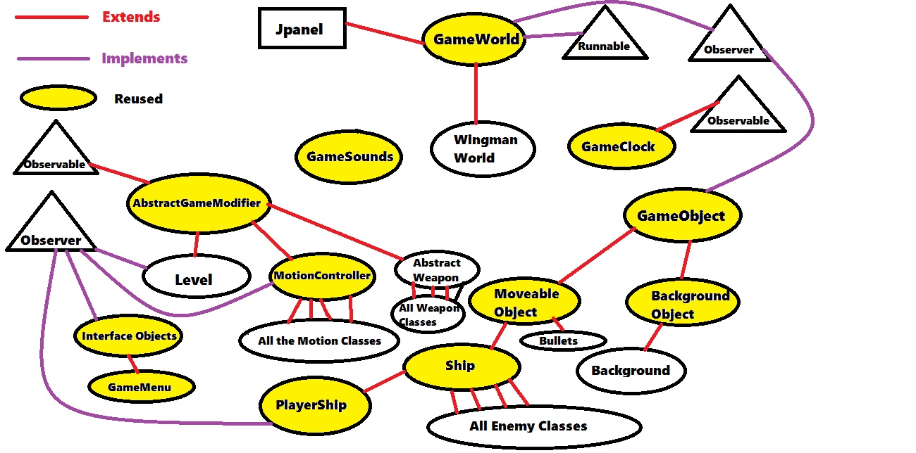
Reusability

Slide 5
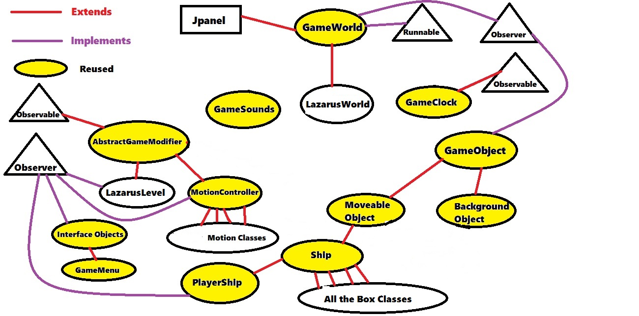
Reusability (cont)

Slide 6
Improvements
Add more comments
Better javadoc comments
Restart game when player dies
Animations
More Levels

